Slide 1






Docker Deep Dive
Introduction to Docker
Docker Deep Dive

Slide 2


What is Docker?
Docker :
The company Docker, Inc.
Docker the container runtime and orchestration engine
Docker the open source project (Moby)

Slide 3

The Company
Docker, Inc. :
Based out of San Francisco
Found by Solomon Hykes
Started as a PaaS provider called dotCloud
dotCloud leveraged Linux containers
Their internal tool used to manage containers was nick-named Docker
In 2013, dotCloud was rebranded as Docker

Slide 4

The Runtime and Orchestration Engine
The Docker runtime and orchestration engine :
Most people are referring to the Docker Engine
Two main editions:
Enterprise Edition (EE)
Community Edition (CE)
Both are released quarterly
CE is supported for 4 months
EE is supported for 12 months

Slide 5

The Open-Source Project
Moby:
The upstream project of Docker
Breaks Docker down into more modular components
Code is available on GitHub: https://github.com/moby/moby

Slide 6

Why Use Docker?
Docker Use Cases:
Dev/Prod parody
Simplifying Configuration
Code Pipeline Management
Developer Productivity
App Isolation
Server Consolidation
Debugging Capabilities
Multi-tenancy

Slide 7
Docker
Containers Vs. Virtual Machines

Slide 8
Containers Vs. VMs?
What is a Virtual Machine?
In basic terms, a virtual machine (often referred to as a “VM” for short), is
an emulation of a specific computer system type. They operate based on the
architecture and functions of that real computer and its implementation
can involve specialized hardware, software or both.
When you think of a virtual machine, you probably think of VMWare, Citrix
and/or VirtualBox. Virtualization software allows you to set up one operating
system within another. Although they both share the same physical hardware,
the virtual machine is isolated from that hardware and has to communicate
with it through something called a Hypervisor.

Slide 9
Containers Vs. VMs?
What is a Container?
A container is exactly what you might expect it to be based on the general
definition of the word. It is an entirely isolated set of packages, libraries and/or
applications that are completely independent from its surroundings.
In the simplest example, you place your leftovers in a plastic container and then
set it on the table. Although the table lends the platform on which the
leftovers are resting upon, they are independent of the table itself. What you
do to one does not necessarily affect the other (although in certain instances it
can).

Slide 10
Containers Vs. VMs?
Why is the difference important?
As in most things in life, the importance is in perspective. From the perspective
of getting the most performance out of the hardware purchased, virtualization
was invented to allow us to share but segregate server instances from each other.
This way, we could protect one operating system from another without letting
spare CPU cycles, memory or disk space go to waste.
Now, virtualization is becoming more granular. We have virtual servers, but they
are based on emulating virtual hardware through a hypervisor. This means that
they are heavy in terms of system requirements. Containers however, use
shared operating systems and are more efficient in system resource
terms.

Slide 11
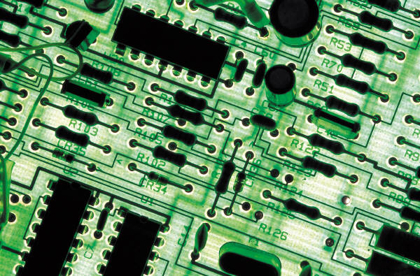

Containers Vs. VMs?
Summary:
Although the differences may seem subtle, as we continue our exploration of Docker, you will see the many difference in Virtual Machines vs. Containers as being extremely important. We continue to maximize what we get out of our systems by more and more granular management of our resources.

Slide 12

Docker Deep Dive
Docker Images and Containers
Docker Deep Dive

Slide 13

What are Docker Images?
Docker Images:
Use images to create an instance of a container
Comprised of multiple layers
Build time constructs
Built from the instructions

Slide 14

Docker Images and Layers
Images are made of multiple layers
Each layer represents an instruction in the image’s Dockerfile
Each layer, except the very last one, is read-only
Each layer is only a set of differences from the layer before it
Containers add a new writable layer on top of the underlying layers
All changes made to a running container are made to the Container layer

Slide 15
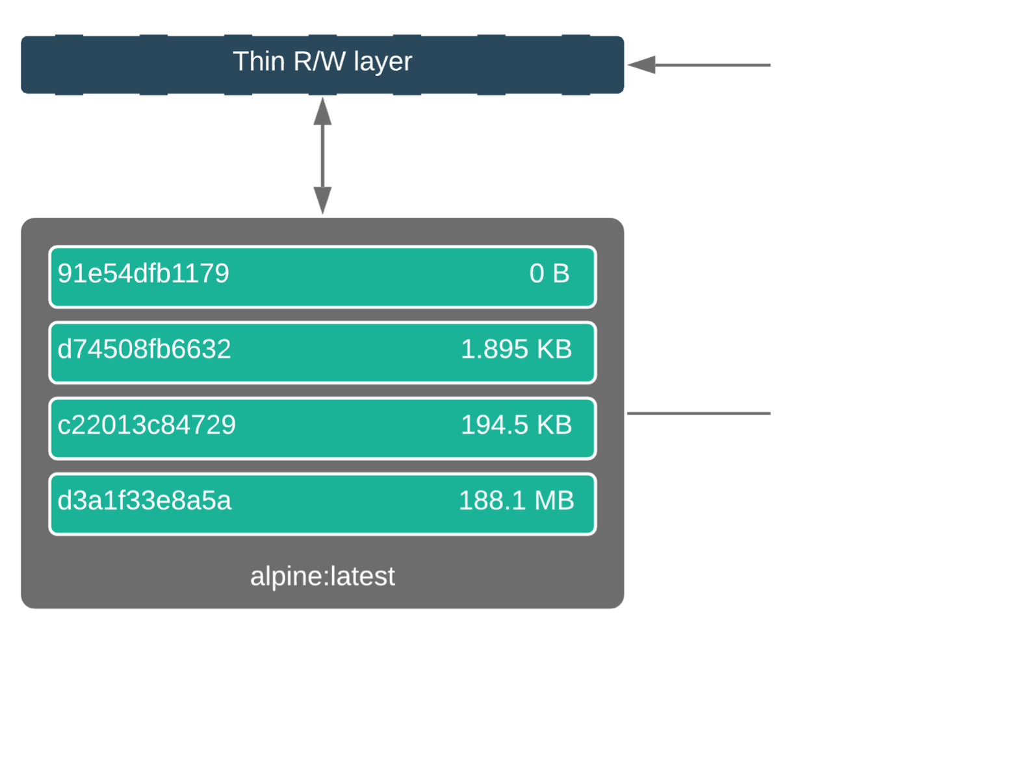
Docker Images and Layers (cont.)

Slide 16

Container and Layers
Top writable layer
All changes are stored in the writable layer
The writable layer is deleted when the container is deleted
The image remains unchanged

Slide 17
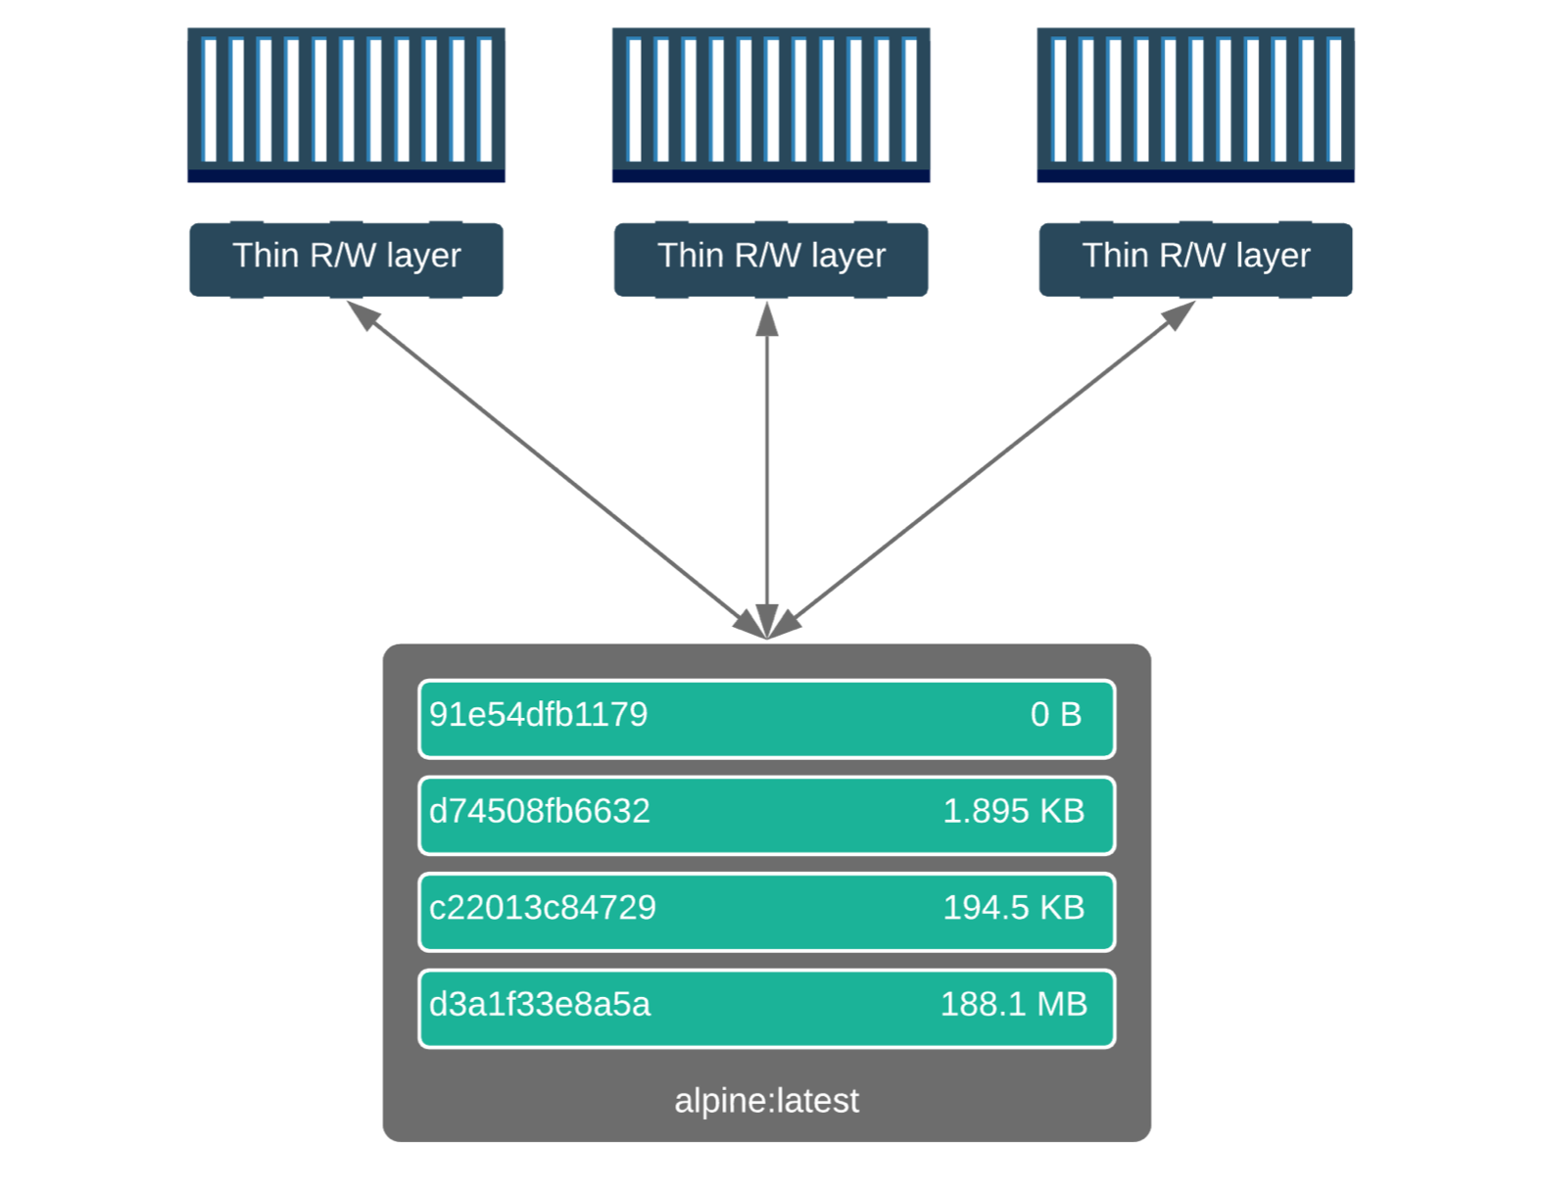
Container and Layers (cont.)

Slide 18

Containers
Container Use Cases:
Tasks
Used to perform one-off jobs
Long-running processes (LRP)
Run until terminated

Slide 19

Docker Deep Dive
Docker Architecture
Docker Deep Dive

Slide 20

Architecture Overview
Docker architecture:
Client-server architecture
The client talks to the Docker deamon
The Docker deamon handles:
Building
Running
Distributing
Both communicate using a REST API:
UNIX sockets
Network interface

Slide 21

Architecture Overview (cont.)
The Docker daemon (dockerd):
Listens for Docker API requests and manages Docker objects:
Images
Containers
Networks
Volumes
The Docker client (docker):
Is how users interact with Docker
The client sends these commands to dockerd
Docker registries:
Stores Docker images
Public registry such as DockerHub
Run your own private registry

Slide 22
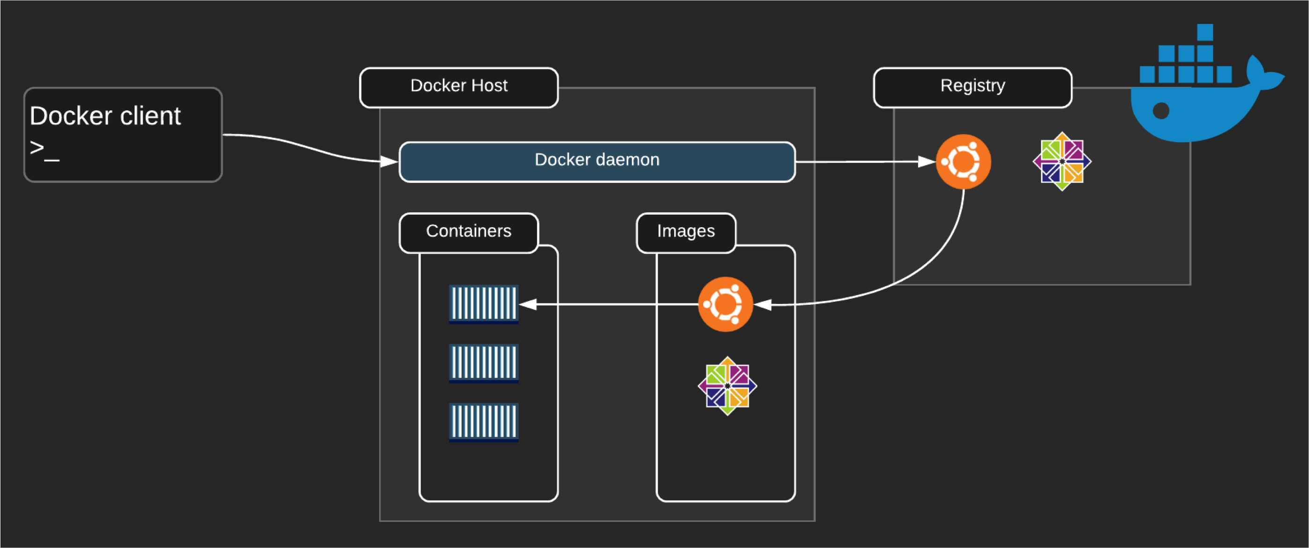
Architecture Overview (cont.)

Slide 23

Architecture Overview (cont.)
Docker objects:
Images
Read-only template with instructions for creating a Docker container
Image is based on another image
Create your own images
Use a Dockerfile to build images
Containers
Runnable instance of an image
Connect a container to networks
Attach storage
Create a new image based on its current state
Isolated from other containers and the host machine

Slide 24

Architecture Overview (cont.)
Docker objects:
Services
Scale containers across multiple Docker daemons
Docker Swarm
Define the desired state
Service is load-balanced Docker Swarm:
Multiple Docker daemon (Master and Workers)
The daemons all communicate using the Docker API
Supported in Docker 1.12 and higher

Slide 25








Docker Deep Dive
The Docker Engine
Docker Deep Dive

Slide 26



Under The Hood
Docker engine :
•
Modular
in design:
•
Batteries included but
replaceable
•
Based on an open-standards outline by the Open Container
Initiative
•
The major
components:
•
•
Docker
Docker
client
daemon
•
•
containerd
runc
•
The components work together
to create and run containers
Docker Deep Dive

Slide 27
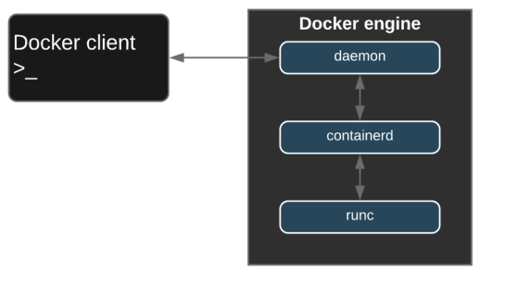
Under The Hood (cont.)
Docker Deep Dive

Slide 28

A Brief History of the Docker Engine
The first release of Docker
•
The Docker
daemon
•
•
•
•
•
•
•
•
Docker
Docker
client
daemon
Monolithic binary
Docker client
Docker API
Container runtime
Image builds
Much more...
LXC
•
•
•
•
Namespaces
Control groups (cgroups)
Linux-specific
Docker Deep Dive

Slide 29
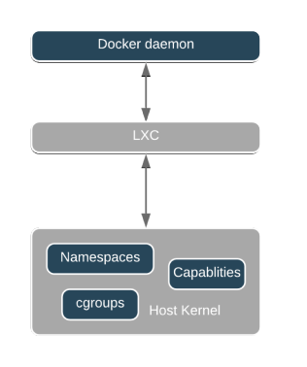
A Brief History of the Docker Engine (cont.)
Docker Deep Dive

Slide 30

Refactoring of the Docker Engine
LXC was later replaced with libcontainer:
•
Docker
0.9
•
Platform agnostic
Issues with the monolithic Docker daemon:
•
Harder
to innovate
•
Slow
•
Not
what
the ecosystem wanted
Docker became more modular:
•
Smaller
more specialized tools
•
Pluggable architecture
Docker Deep Dive

Slide 31

Refactoring of the Docker Engine (cont.)
Open Container Initiative:
•
Image spec
•
Container
runtime spec
•
Version 1.0 released in 2017
•
Docker,
Inc.
heavily contributed
•
Docker
1.11
(2016) used the specification as much as possible
Docker Deep Dive

Slide 32

Refactoring of the Docker Engine (cont.)
runc
•
Implementation of
the OCI
container
-
runtime
-
spec
•
Lightweight
CLI wrapper
for
libcontainer
•
Create containers
containerd
•
Manage container
lifecycle:
•
•
•
•
Start
Stop
Pause
Delete
•
Image management
•
Part
of
the 1.11
release
Docker Deep Dive

Slide 33

Refactoring of the Docker Engine (cont.)
shim
•
Implementation of
daemonless
Containers
•
containerd forks an instance of
runc for
each new container
•
runc process exits after
the container
is created
•
shim process becomes the container
parent
•
Responsible for:
•
•
STDIN and STDOUT
Reporting exit status to the Docker daemon
Docker Deep Dive

Slide 34

Running Containers
docker container run -it --name <NAME> <IMAGE>:<TAG>
Creating a container:
•
Use the CLI
to execute a command.
•
Docker
client
uses the appropriate API payload.
•
The command
POSTs to the correct
API endpoint.
•
The Docker
daemon receives instructions.
•
The Docker
daemon calls
containerd to start
a new container.
•
The Docker
daemon uses
gRPC,
a CRUD style API.
•
containerd creates an OCI
bundle from the Docker
image.
•
Tells
runc to create a container
using the OCI
bundle
•
runc interfaces with the OS
kernal
to get
the constructs needed to create a container
Docker Deep Dive

Slide 35

Running Containers (cont.)
Creating a container:
•
This includes namespaces,
cgroups,
etc.
•
The container
process is started as a child process
•
Once the container
starts
runc will
exit
•
Which completes the process and the container
is now running
Docker Deep Dive

Slide 36
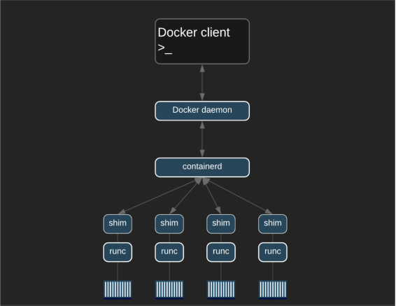
Process Summary
Docker Deep Dive

